Slide 1

WAIU – Experience Luxury At Convenience

Slide 2








Truevibez : Mission, Vision & Values
Mission:
To create a global service provider of hospitality industry, realizing pioneering advancements in established services and accomplish mutual growth for both our partners & customers
Vision:
Truevibez is dedicated to provide modern & innovative solutions to our hospitality partners, via introduction of technology evolution in their offerings and creating avenues of inspiring new business horizons.
Values:
Innovation through Leadership : To become vanguard of hospitality experience enrichment
Modernization & Elegance : To develop ultramodern hospitality business solutions
Focus & Evolution : Relentlessly strive to improve business value through performance

Slide 3
Founder : Rajesh Karandikar
Rajesh Karandikar is owner of Hotel 24K chain of restaurants in Maharashtra (MH) & Director of Truevibez Pvt. Ltd.
Rajesh is a government media partner as an empanelled member of DGIPR & has executed a range of promotional and awareness campaigns such as:
Edutainment program for Primary & Secondary school in collaboration up with Discovery channel
Cloud seeding program across MH in 2018 under Ministry of Earth Sciences
Executed disaster management week with NDRF for government offices & schools, in 463 tehsils
Rajesh holds MBA in Marketing stream & after spending time at several corporate positions in Delhi, Mumbai & Pune, he applied his entrepreneurial skills in hospitality industry and started the Hotel 24K chain of restaurants, originating in Kolhapur, Maharashtra.
The implementation was an instant success, something which he has now replicated in Pune at premium locations as Balewadi High Street & Viman Nagar IT City. With 3 active restaurants now, Rajesh is also enrolled as an honorary member of Craft Brewers Association of India, successfully running a Craft Brewery in Pune.
To extend his expertise further in hospitality business, Rajesh has founded company Truevibez Pvt. Ltd., with Alok Sambuddha, that aims to explore and introduce innovative technology solutions in hospitality industry to take customer experience to completely new & unexplored levels.

Slide 4
Founder : Alok Sambuddha
Alok Sambuddha is Engineering Director in American Express, United Kingdom & Director of Truevibez Pvt. Ltd.
Alok is a Mechanical Engineer from Pune University with broad experience in IT industry, working with prominent MNCs as Cisco, Infosys, Atos and now American Express.
Alok’s specializes in merchant acquisition domain and developing technical platforms to support end to end merchant lifecycle services such as affiliation, enablement, submissions, payments, reconciliation, compliance, MIS, AML, Risk, Finance & Accounting.
He also leads solution development framework across technologies like Mainframes, Java, Dot Net, supported via both Agile & Waterfall delivery models. He provides corporate and architectural consultation to business & technology teams to develop flexible solution frameworks & heads the implementation committee.
Alok’s primary geography of operation is Europe (EMEA) and has spent most of his career in Brighton, UK, at the European technology head office of American Express.
Alok has critical presence in merchant management landscape and aims to extend his experience through technical evolution of traditional hospitality business and modernize the F&B service offering for digital citizens in partnership with Rajesh Karandikar.

Slide 5
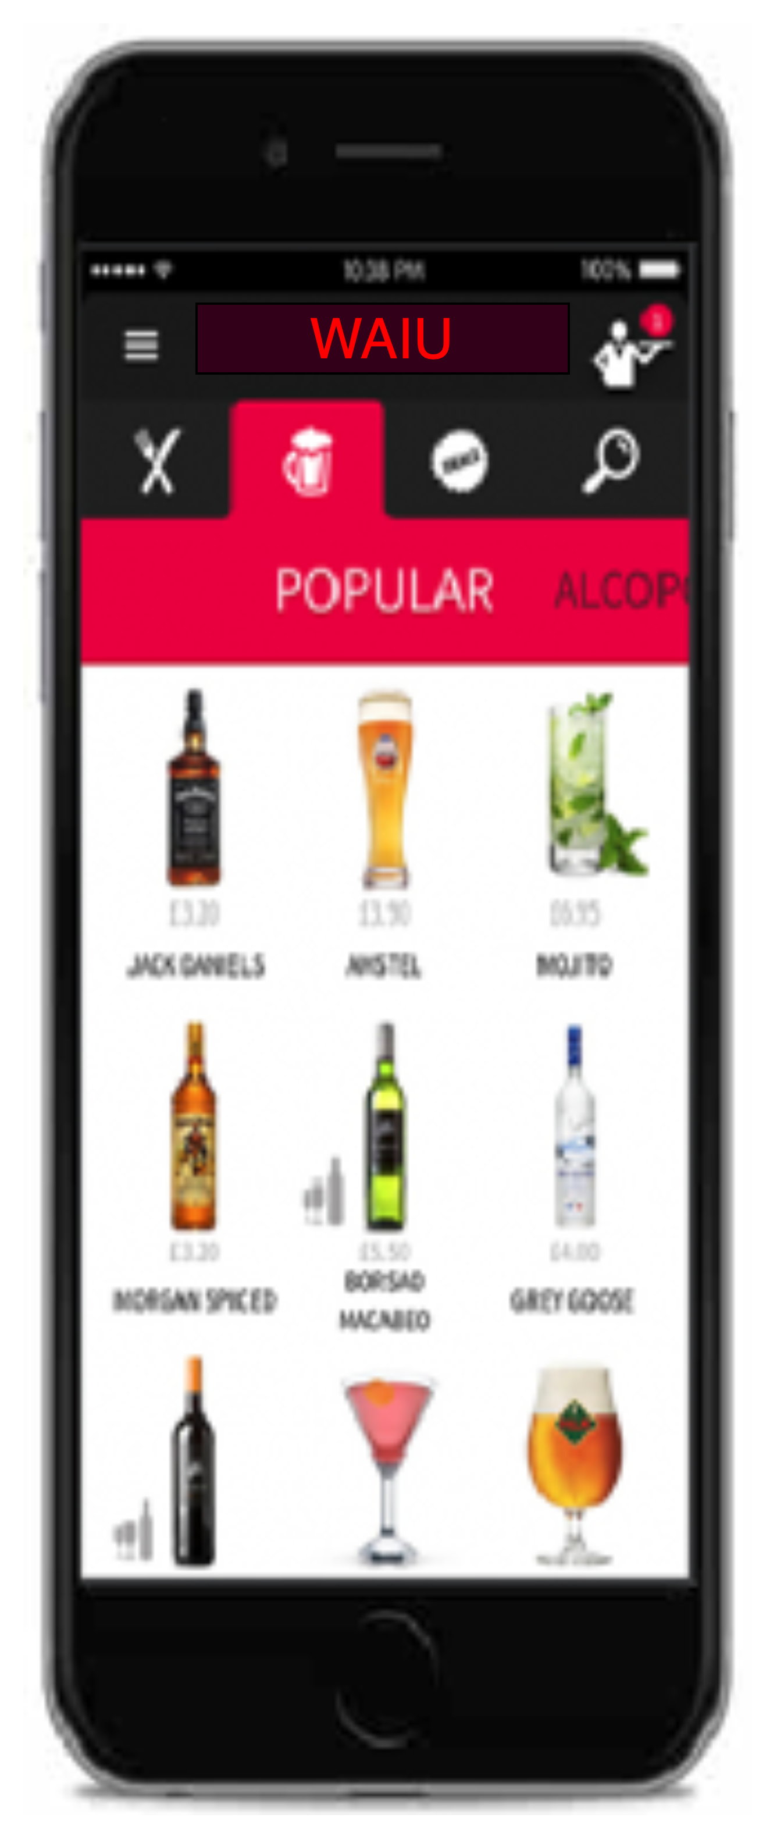








Program WAIŪ : Product & Features
Gift a Friend
Gift or share an item of choice to your beloved ones – Family & Friends, Colleagues, Corporates
Broadcast & Live Streaming
Watch exclusive live shows of your favorite artists & performers
Logistics & Governance
Reduced expenses through aggregator independence, merchant governance support & staff training
F&B Services
Instant cashback facility for regular customers to avail restaurant services
Offer a New Friend
Offer service will be availed at merchant establishment with other groups or individuals
Events & Gaming
Promote corporate events, interactive games for in-house patrons
Payments & PBS
Express true feeling of sharing & gifting with points instead of money
Clique - Dine Now, Pay Later
Privileged credit services for the our NBFC/MFI partner’s customers

Slide 6



DNPL – An Opportunity under Truevibez Umbrella
WAIU Dine Now, Pay Later is premium service offered to our finest customers & business partners, to mutually benefit through means of microfinancing services.
Dine Now, Pay Later
For customer expecting an event to visit restaurant but without available liquid funding, WAIU will open up a line of credit in handshake with a lender (NBFC). The customer can request this restaurant-focused credit line and once approved, use it at any partner restaurant. Launching with 200 restaurants in Pune, we aim to expand to 10 key cities by EOY and have 4000 restaurant partners by 2023.
Merchant Staff Financial Lending
Restaurant staff currently face many challenges in requesting loans from banks and NBFCs however from recommendation of a partner merchants, a low-medium size credit pool will be made available to them with flexible repayment options.
With microfinance market anticipated to grow with CAGR of 40% through 2025, NBFC-MFIs will be its greatest beneficiaries. In F&B segment, unbanked microlending has only reached 12-15% of the prospective market.

Slide 7
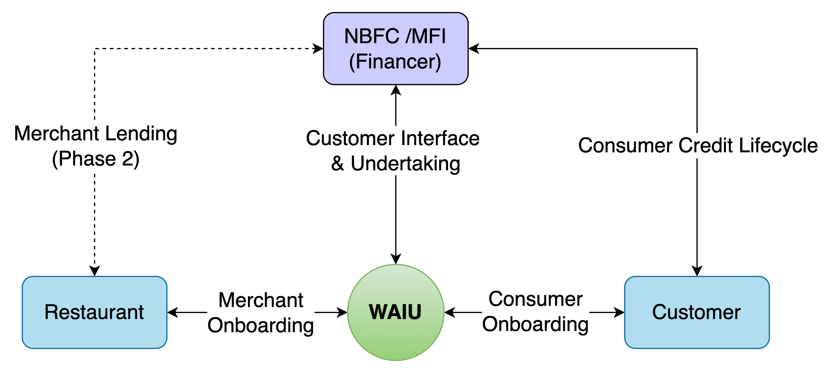
WAIU – High Level System Flow
WAIU pilot is planned in Kolhapur, Maharashtra in March-2022, with in initial partnerships with 50 top restaurants.
WAIU launch is planned in Pune, Maharashtra in April-2022, with in initial partnerships with 200 top restaurants.
By end of 2022, WAIU will be expanded in 10 key cities across India, with a partner merchant base of 3000+
Each restaurant to have average of 5000+ customers per restaurant, allowing a significant solution coverage
Platform development is complete with merchant signup & brand positioning and collaterals in design
WAIU will expand to Tier-2 cities by end of 2022, to support its NBFC partners already operational there
Wider WAIU Phase-2 features, including merchant lending, will be launched in Q3 2022.

Slide 8
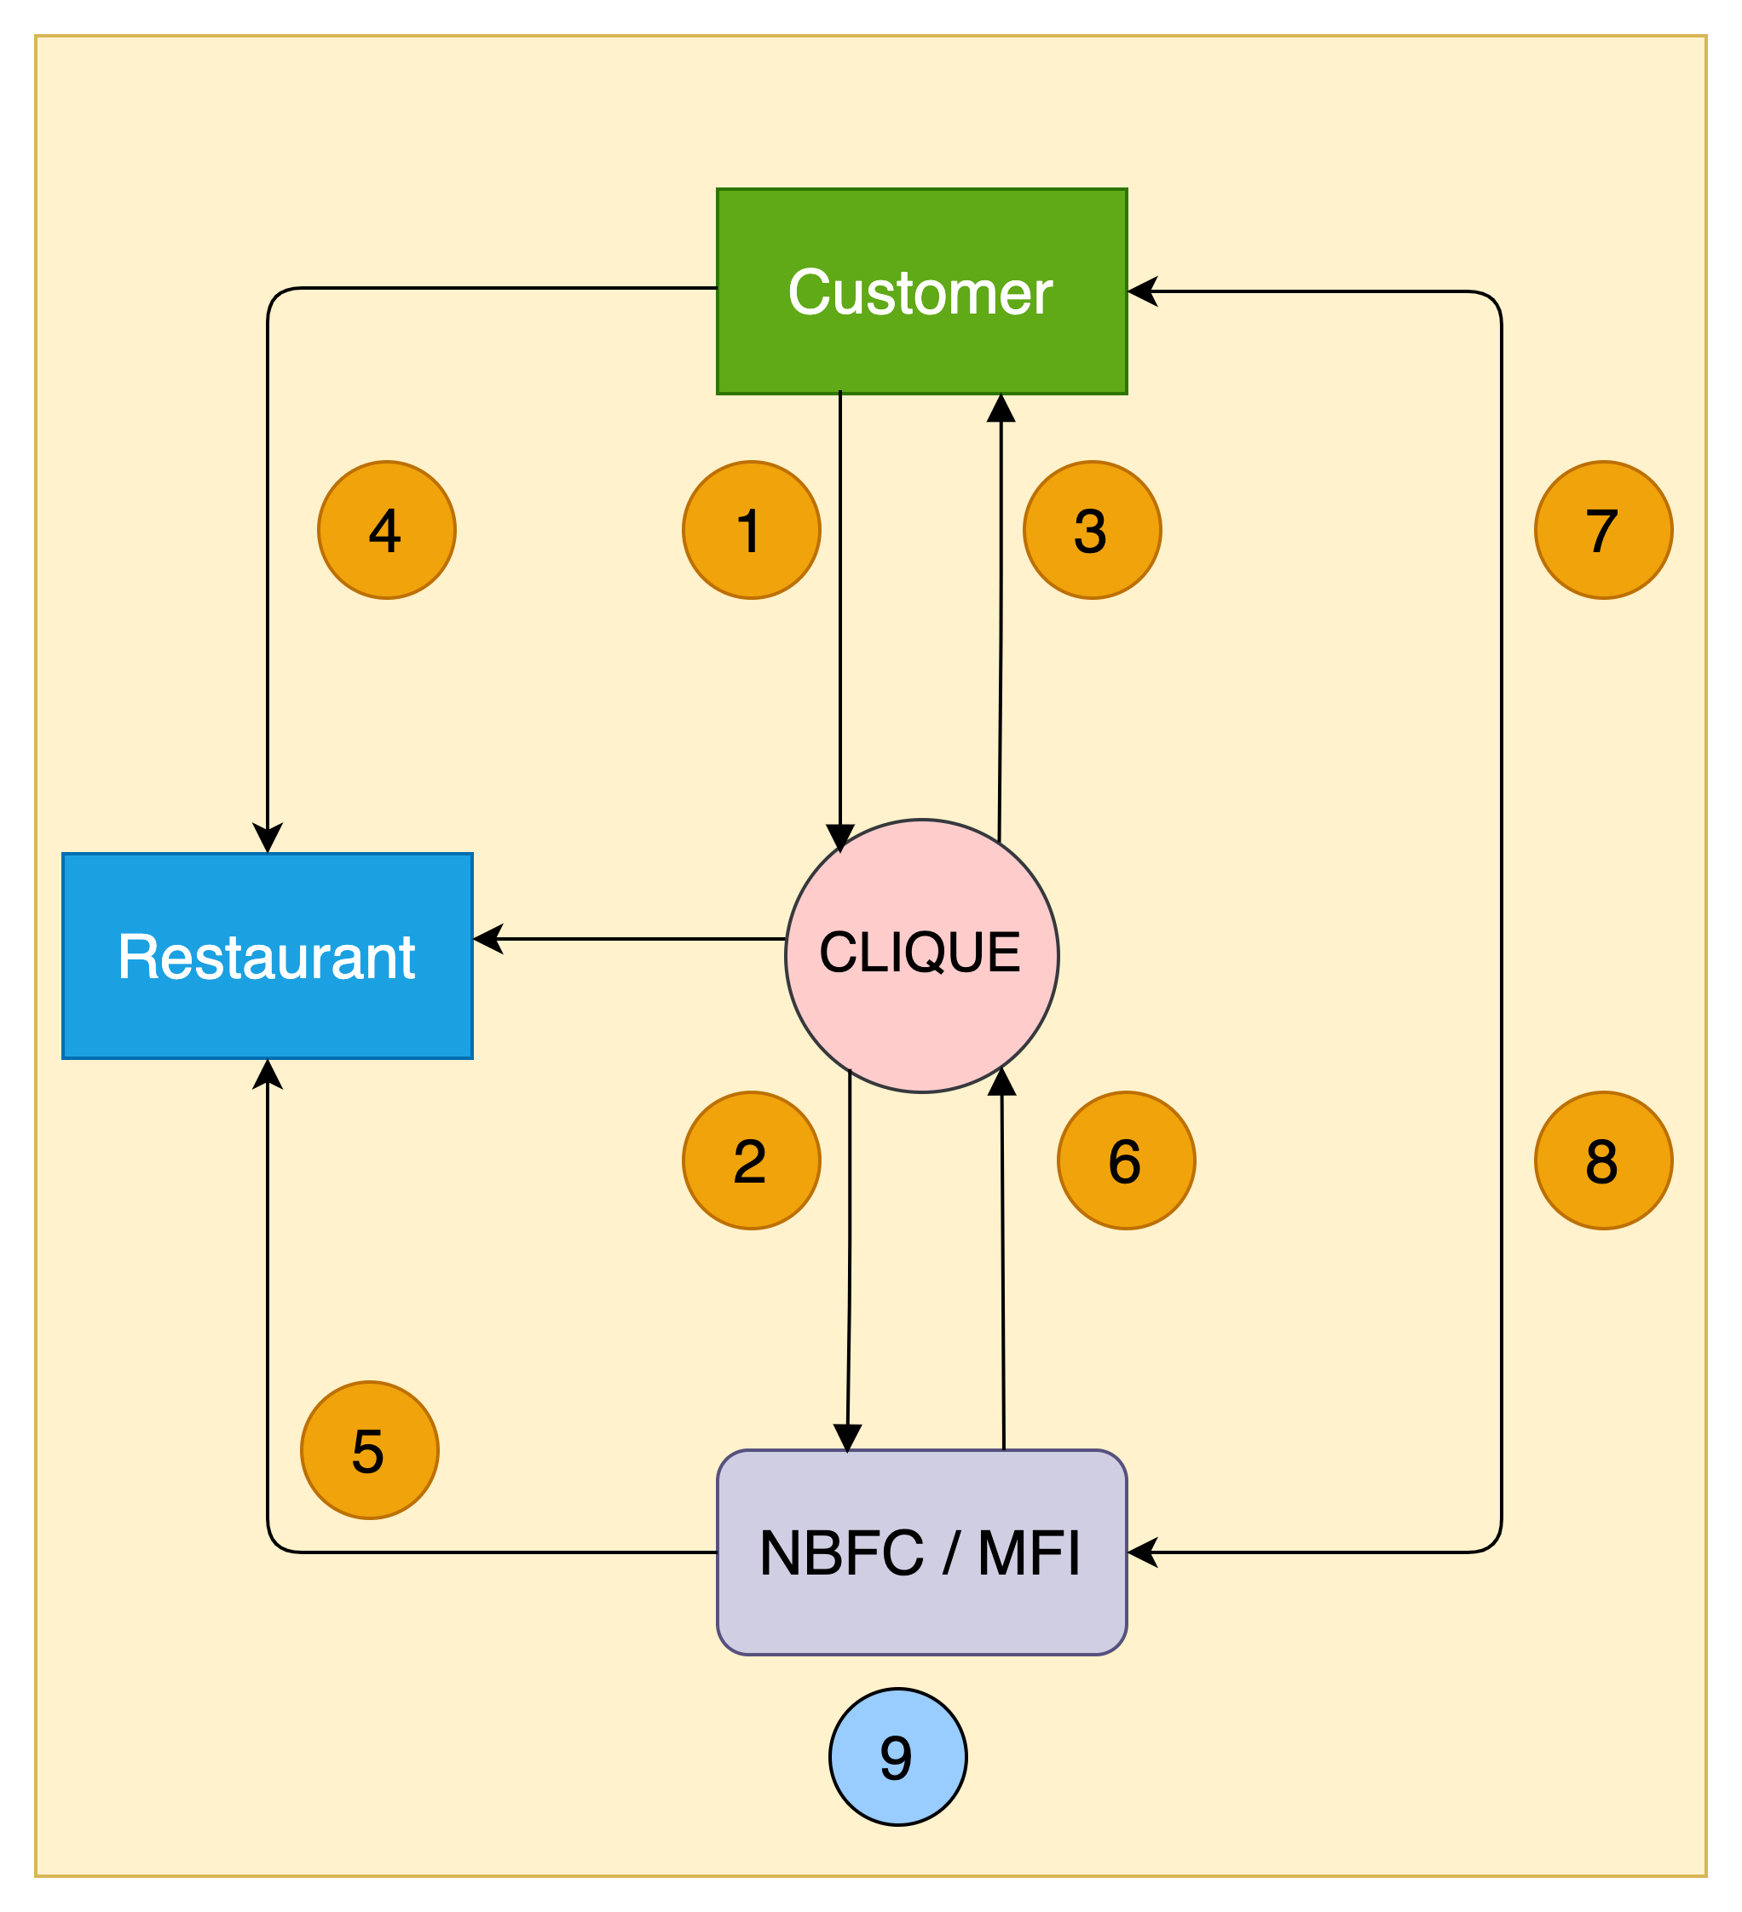
DNPL – High Level Transaction Process Flow
1. Customer walks into a restaurant & applies for the wallet credit through WAIU App
2. WAIU receives customer application & send it to the lender for underwriting & respond with approval or rejection
3. Customer app wallet is credited with approved funds & signs NACH mandate
4. Customer utilises the wallet credit at the restaurant e.g., Rs 5000
5. Lender pays the merchant (less the operational charges) based on merchant's billing cycle e.g., Rs 4000
6. Lender pay the commission to WAIU e.g., Rs 800 based on payment reconciliation, on agreed frequency
7. Customer pays lender later based on agreed T&C,
including interests, delay charges etc.
8. Once paid, even if partially, lender updates WAIU to reset
customer’s wallet for calculated funds for further utilisation
9. Lender keeps the balance i.e., Rs 200, for their services

Slide 9
WAIU – Customer Onboarding Journey
02
Customer reviews standees, flyers, tent cards and informed by staff about Clique
03
Customer downloads Clique app and completes KYC application
01
Customer walks into
a restaurant
Clique routes the application to lender
06
Lender sends a confirmation back to Clique
04
05
Lender underwrites the customer
07
Clique updates customer app and reflects the wallet credits
08
Customer enjoys the F&B services
09
Customer pays through clique credit & returns home

Slide 10
Merchant – Engagement & Growth
Surge
Grow
Retain
Deploy
Attract
Engage
Relate
Identify Key Concerns
Show Importance
Reflect Passion
Media Interaction
Uncover Strategy
Unveil Edge
Compare results
Events
Interaction
Awards
Felicitation
Awareness
Collaboration
Customer Care
Clique Pilot
POC / Beta
Clique Launch
Full Service
Governance
Value Adds
Ease of Business
Business Boost
Referrals
Engagement
Statistics & Analytics
Product Placement
Features services
Volume Boost
Upselling
Cross Move
Up-cycling
Dynamic Pricing
Scoring / Rating
Feedback
WAIU Launch
Added Products
Promote
Memberships
Customer engagement
Logistics
Governance

Slide 11
Merchant – Elevated Pitch
Increased Profit Margins
Of restaurants by onboarding brand new customers & rotate existing customer more often
Cross Industry Alliance
Merchants to benefit from Clique partnerships like Pune Mirror, Sakal, Banks & Lenders
New Product & Features
To be offered to customers for extended loyalty & addition premium clientele
Larger Ticket Size
Eat Now Pay Later customers to spend an average of 15-30% higher on F&B services
High Customer Retention
To continue their quality service & more to existing customers without any additional expense
Merchant, Staff & Consumer Lending
To support merchant financial needs without bank audit & documentations

Slide 12
Customer – Elevated Pitch
New Product & Features
Credit line facility for F&B services during need and additional guaranteed benefits of dining out
New Borrowing Avenue
By utilizing existing relationships and financial network portfolio in an organized & professional manner
Bio-Authorization For Enhanced Safety
Reactive Credit Scoring
To allow customers to increase credit line for more benefits & increased financial literacy
Best Rates & Flexible Terms
With long risk-free no-interest paying term, along with a range of payment plans at offer with different lenders to choose from
No Fees & Ease of Use
Simple to use service without any hidden costs, allowing decorum & savings
On Demand Spending Potential
No more dependency on regular cash flows & a flexible solution for all occasions combined with increased risk-free spending potential

Slide 13
WAIU – 360° Benefits
Eat now, Pay Later
Consumers | Restaurants | MFI-NBFC
Increase in spend potential | Increased sales | New customers
Bio-authorization to reduce risks | Higher ticket size | Increased presence
No joining or renewal fees | New feature to offer | Competitive edge
Decorum & savings | No additional charges | Innovative offer
Microfinancing
Consumers | Restaurants | MFI-NBFC
Increased borrowing potential | Self-sufficiency at competitive rates | Untapped market – Millennials, Zoomers
Enhanced financial literacy | Standardized & organized system | Inclusive growth
Reactive credit scoring | Reduced regulatory challenges | Valued partnership
Better rates than banks | Co-branding opportunities | Benefit from geographic expansions

Slide 14
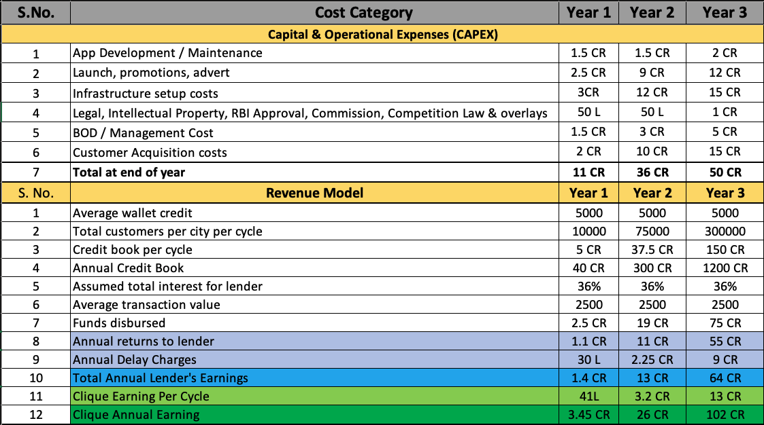
WAIU – Revenue & Expenses

Slide 15
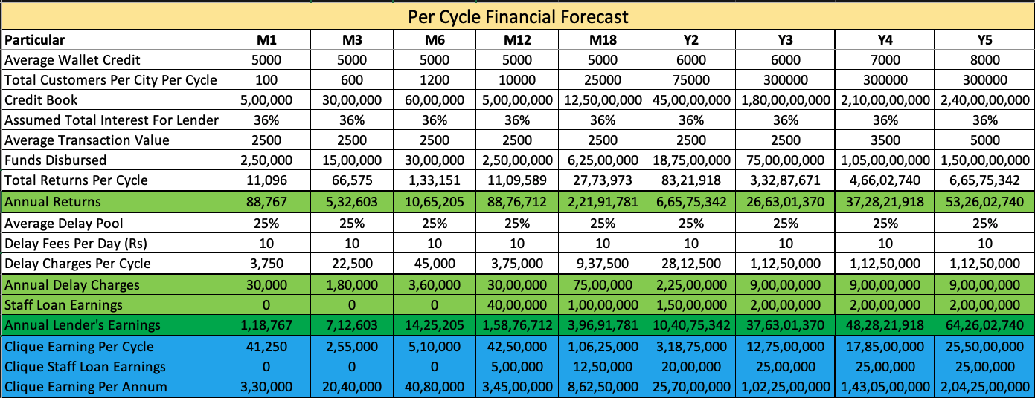
WAIU DNPL: Financial Forecast – 5 Years
Notes
Conservative assumption that 2nd cycle to start only when 1st one is complete

Slide 16
WAIU – Phased Plan – Year 1
S.NO. | Phase & Scope | Timeline | Funding | Notes
1 | - WAIU development - NBFC Integration | Feb-22 | 1 CR | - NBFC integration & Banking setup - Technical development & TPP costs
2 | - WAIU B2B Event in Kolhapur - Pune market research - Merchant Acquisition & setup - Additional NBFC integration Initiate: Customer Acquisition | Mar-22 | 50 L | - Partial infrastructure costs across locations - Acquisition Events & marketing expenses - POC expenses - Infra Setup (Office, Resourcing)
2 | - Kolhapur Launch - Core Team Setup - Pune B2B Event & POC - Pune Launch - Kolhapur Marathon Promotion Initiate: Bank partner integration | Apr-22 | 1 CR | - Partial infrastructure costs across locations - Acquisition Events & marketing expenses - POC expenses - Infra Setup (Office, Resourcing)
3 | - Bank customer enablement - Supplimentary account activation - WAIU full service launch Continue: - Acquisitions & Value added features | May-22 | 1 CR | - Partial infrastructure costs - Partial Op-Ex, Audit & overlays - TPP costs - APIs, Servicing - PPI & other overlays
4 | - Mumbai Launch - Media & advert drive | Jun-22 | 50 L | - Campaigining - TVC, Advetorial, 360* Media - Full infrastructure costs - Y1 Full Op-Ex & BOD
5 | - Goa Launch - Horizontal expansion - Commercial bank integration - NPCI Onboarding | Jul-22 | 1 CR | - Service Provisioning costs - Digital Customer Acquisition
S.NO | Phase & Scope | Timeline | Funding | Notes
6 | - Operations & expansion - Governance service development - Bangalore Launch | Aug-22 | 1 CR | - Multi Lender Integration - Marketing & promotions - Customer support & technical development
7 | - WAIU Operations & expansion - Sharing service development - NCR Launch | Sep-22 | 1 CR | - Core service development & readiness
8 | - WAIU Operations & expansion - Gaming service development - Hyderabad & Indore launch | Oct-22 | 50 L | - Core service development & readiness
9 | - WAIU Core service launch - All city all service full launch | Nov-22 | 1 CR | - Core service development & readiness
10 | - WAIU Operations & expansion - Ride Now, Pay Later integration | Dec-22 | 50 L | - Promote both core and credit services together
11 | - WAIU Operations & expansion - 2023 Media drive & Events | Jan-23 | 1 CR | - Promote both core and credit services together
12 | - WAIU Operations & expansion | Feb-23 | 50 L | - Promote both core and credit services together
13 | - WAIU Operations & expansion - Ride Now, Pay Later launch | Mar-23 | 50 L | - Promote both core and credit services together

Slide 17
Phase-wise Funding & Investment Options
S. No. | Period | Activity Description | CAPEX - Year 1 | OPEX - Year 1 | Total - Year 1
1 | Apr-May-Jun 2022 | Top 5 launch, Event organization (Kolhapur Marathon), Media & advertisement drive | ₹ 2,50,00,000 | ₹ 50,00,000 | ₹ 3,00,00,000
2 | Jul-Aug-Sep 2022 | Next 3 launch, Multi-NBFC integration, WAIU Core service developments, Commercial bank integration | ₹ 2,00,00,000 | ₹ 1,00,00,000 | ₹ 3,00,00,000
3 | Oct-Nov-Dec 2022 | Final cities, PPI license, WAIU full service launch across geographies, Ride-Now-Pay-Later development | ₹ 1,00,00,000 | ₹ 1,00,00,000 | ₹ 2,00,00,000
4 | Jan-Feb-Mar 2023 | 2023 media drive, WAIU horizontal expansion, Ride-Now-Pay-Later launch | ₹ 1,00,00,000 | ₹ 1,00,00,000 | ₹ 2,00,00,000
Totals |  |  | ₹ 6,50,00,000 | ₹ 3,50,00,000 | ₹ 10,00,00,000
S. No. | Funding Need | Equity | Debt (Optional) | Debt Period
1 | 10 CR | 15% | 18 CR | 3 Years
2 | 10 CR | 5% | 25 CR | 3 Years
3 | 10 CR | 3% | 15 CR | 2 Years

Slide 18
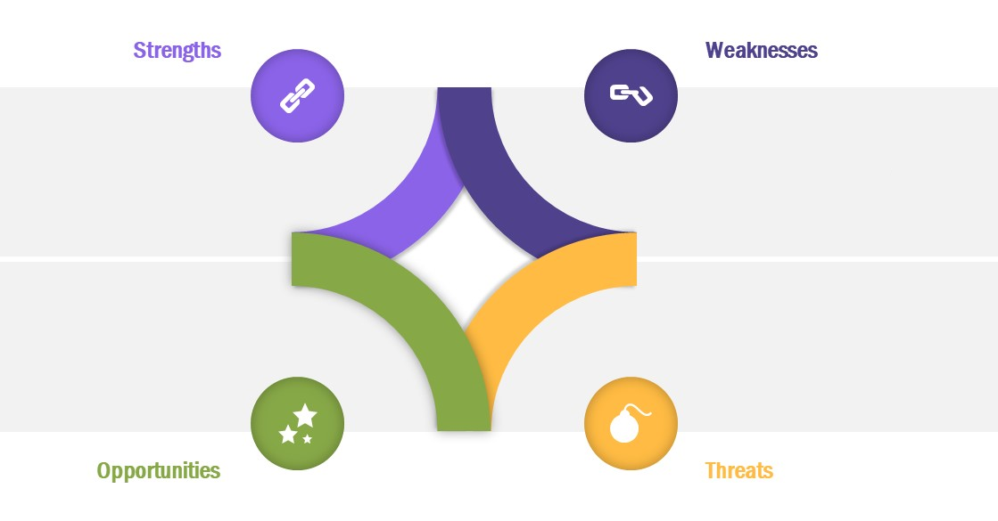
SWOT Appraisal
Unique service offerings
Cross-industry appeal
Digital marketing enabler for merchants
Payment flexibility for consumers
Brand Establishment
Competition from current market leaders
Credit cards, as an alternative
First mover’s advantage
Rising customer expense on comfort
Additional borrowing option for consumers
Hospitality is an unexplored lending market
Technology innovation
Expansion of existing service aggregators into hospitality business
Global players developing BNPL products

Slide 19







PAYO (Australia) – A case study
About PAYO
PAYO is an Australian company who have launched the world’s first Eat Now, Pay Later service in July 2021.
The are backed by an existing lender with substantial customer base in the operational regions.
Being the World’s first ENPL app, they have favorably placed themselves as market disrupters, driving investor’s interest & confidence.
Within 3 months of launch, 700+ merchants in 4 cities & growing at the pace of 200 merchants every month
All payments are divided across 4 interest free EMIs, with only a quarter of payment to be made upfront.
Top performing 50 restaurants have received thousands of transactions with recorded order value increase of 60%
Diners can discover restaurants, filter by preferences, call restaurant, book table and receive range of offers & deals.
Both restaurants & customers are incentivized for referring more paying users to the platform
All payments are via PAYO app via QR codes with options for customer to recommend for PAYO business
Instant approval & discreet process has given PAYO an edge over other modes of payments, eliminating need to carry wallets

Slide 20
Customer Acquisition Strategy
Merchant Acquisition Strategy | Consumer Acquisition Strategy | Notes
Direct sales via dedicated regional teams (10 per location per month) | WAIU direct acquisition (6-8k per location per month) | WAIU service acquisitions
Corporate collaborations with multi-location hospitality brands | Aggregation based model to increase time to market | To enable increased time to market
Pre/Post launch promotional & marketing campaigns | Social media & network advertisements | Combination of digital & traditional strategies
Network tie-ups and contact center for customer servicing | Event tie-ups e.g., Ridermania, Ruggedian

Slide 21
Corporate Partnership
S. No. | Partner | Role
1 | NPCI | Nth Reward Loyalty platform onboarding & campaigning platform
2 | Cosmos Bank / Lokmanya Co-Operative Society | Value add service to bank customers via bank's super-app
3 | KPMG | RBI regulatory compliance and licensing services
4 | Payu Finance (Lazypay) | Financial lending service provider
5 | ZestMoney | Financial lending service provider
6 | Early Salary | Financial lending service provider
7 | LoanTap | Financial lending service provider
8 | Michael Dell Foundation | Financial lending service provider
9 | Suniel Shetty (Popcorn Entertainment) | Brand Ambassador
10 | TOI, Pune Mirror | Media & Advertorials
11 | SonyLiv | Entertainment and broadcast services
12 | Stratacache (SCALA) | Broadcast infrastructure and CDN
13 | Sazinga Digital | Technical platform development & maintenance

Slide 22
Our Team
Promoters
Rajesh Karandikar
Alok Sambuddha
Board Of Advisors
Rahul Renavikar :Managing Director, Acuris Advisors (GST & Government Policies) – Ex. Big 4 & Tata Motors
Chetan Oswal : Accounts & Legal Counsel
Shrikant Chatur : Governance Consultant (ex. VP Commercial - Cummins)
Sanjay Phadke : Fintech Specialist, Ex. EVP Edelweiss & Vayana Network, JP Morgan, HSBC
Rakesh Malhotra : Media Curator, Ex. Media Head - Sakal
Yogesh Katre : Sales Head, Loantap
Harun Rashid Khan : Regulatory Advisor, Ex. Deputy Governor RBI
Vinay Baijal : Regulatory Advisor, Ex. CGM Banking, RBI

Slide 23






Question & Answers

